Slide 1
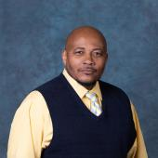

FIGHTING DISCLIPLINE
Presented By National Business Agents,
Clerk Division, APWU, AFL-CIO
James Stevenson James "Jim" DeMauro
Chicago Region Atlanta Region

Slide 2
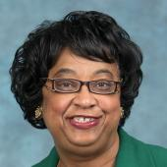
SPONSORED BY THE
APWU, AFL-CIO
RESEARCH AND EDUCATION DEPARTMENT
Joyce B. Robinson, Director

Slide 3
DISCIPLINE
Article 16 of the Collective Bargaining Agreement, (CBA) gives Management the right to discipline employees for misconduct:
  Insubordination,
  Theft;
  Fighting;
  Intoxication (Drugs Or Alcohol);
  Attendance;
  Incompetence;
  Failure to Perform Work ss Requested;
  Violation of the Terms of this Agreement, and/or
  Safety Violations, etc.
Notes:
Note incompetence. We tend to forget people can get disciplined for “honest” mistakes.

Slide 4
STEWARD’S RESPONSIBILITY
Representation – not, judgment.
Competent, thorough, and fair defense.
Objective: to resolve grievances at the lowest step.
Never guarantee an employee that the Union will win their grievance. But, represent them to the best of your ability.

Slide 5
STEWARD’S RESPONSIBILITY CONT.
No substitute for HARD WORK.
Effective & Timely Investigation.
Complete & Thorough Documentation.
Detailed Analysis and Development of All Issues and Arguments.
INVESTIGATION
DOCUMENTATION
ANALYSIS
Notes:
We need to investigate as well. Often to off set the “thorough, fair, impartial” investigation by Management.

Slide 6

STEWARD’S RESPONSIBILITY CONT.
There is no substitute for a timely investigation
Interview all witness.
Obtain Statements.
Collect Documents.
Stewards’ Checklist
√ Conduct Interviews
√ Collect Documents
√ Take Notes
Notes:
Do not let things sit to interview. Note INTERVIEW not statements. Rules of evidence interview gets more weight than statements as statements are hearsay.

Slide 7

CATEGORIES OF DEFENSES
Procedural or Technical Arguments.
Burden of Proof.
Appropriateness of Discipline.
Mitigation.
Notes:
We will over this in future slides

Slide 8
ARTICLE 16, SECTION 1
Section 1. Principles
“ In the administration of this Article, a basic principle shall be that discipline should be corrective in nature, rather than punitive. No employee may be disciplined or discharged except for just cause such as, but not limited to, insubordination, pilferage, intoxication (drugs or alcohol), incompetence, failure to perform work as requested, violation of the terms of this Agreement, or failure to observe safety rules and regulations. Any such discipline or discharge shall be subject the grievance-arbitration procedure provided for in this Agreement, which could result in reinstatement and restitution, including back pay.”
Notes:
Corrective, per the JCIM, is generally viewed as progressive.

Slide 9
JUST CAUSE
Is there a rule?
Is the rule a reasonable rule?
Is the rule consistently and equitably enforced?
Was a thorough investigation completed?
Was the severity of the discipline reasonably related to the infraction itself and in line with that usually administered, as well as to the seriousness of the employee's past record?
Was the disciplinary action taken in a timely manner?
Notes:
Management frequently includes these in both 2608s and step 2 decisions. Be prepared to rebut what they write.

Slide 10
PLAYING BY THE RULES
Is there a rule?
Is the rule a reasonable rule?
Rule should be an element of the charge.
Was the employee made aware of the rule?
Notes:
Forewarning, or being made aware of a rule can be a key to many cases. Not just the just but the discipline level for breaking a rule.

Slide 11
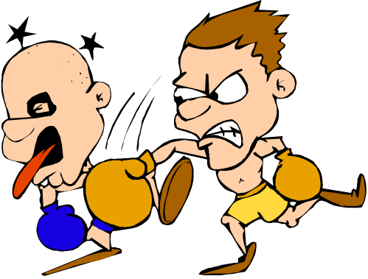

PLAYING BY THE RULES CONT.
Some rules are understood by all.
THEFT
You Can’t Punch Your Supervisor
INTOXICATION
AWOL
FIGHTING
INSUBORDINATION
Notes:
Many of these understood “rules” can result in non-progressive discipline.

Slide 12

PLAYING BY THE RULES CONT.
Was the employee made aware of the rule?
Notes:
Management has to prove the employee was put on notice.

Slide 13
PLAYING BY THE RULES CONT.
?
?
?
Is the rule understood?
?
?
?
ELM 666.81
Employees are required to be regular in attendance.
?
?
?
?
?
?
?
?
?
?
Notes:
While many of us stewards understand the rules employees may not. The ELM is a perfect example of having rules we know and understand, but a person on the floor may not.

Slide 14
DISPARITY AS A DEFENSE
Is the rule consistently
and equitably enforced?
"DISCIPLINE...MUST BE APPLIED WITH A GENERAL SENSE OF EQUITY"
Notes:
Tread carefully if you are going to compare APWU represented employees, unless it is already settled. Example someone was give a 14 day for clocking others in and out for work. Another gets a removal for the same thing, go ahead and use that.

Slide 15
DISPARITY AS A DEFENSE
CONT.
Comparison Employees
  Other Bargaining Unit Employees.
  Supervisors.
Notes:
Go ahead throw carriers & MHs under the bus. Supervisors are held to a higher standard (or at least they should be). Be prepared that Management will NOT provide the discipline, or settlement for a manager. Great as we know they were not fired for their actions as they generally drop them back into a craft.

Slide 16
DISPARITY AS A DEFENSE
CONT.
Where a Rule has not been enforced.
Cannot suddenly “make an example out of an employee” through enforcement without prior notice.
“Any employer has an obligation to inform employees clearly, without equivocation, and without the possibility of misunderstanding, when rules which have been ignored are to be enforced. . .”
Notes:
JCIM as well. Speaks to forewarning again.

Slide 17
PRE-DISCIPLINARY
INTERVIEW AND INVESTIGATION
Was a thorough investigation completed?
  Investigatory Interview.
  Pre-Disciplinary Day in Court.
Notes:
Please very few arbitrators buy the argument there has to be both I & I and DIC. One big exception is when I & I gives some new information to check on, and so a 2nd meeting would be needed regardless of what they call it.

Slide 18

PRE-DISCIPLINARY
INTERVIEW AND INVESTIGATION CONT.
Cleveland Board of Education v. Loudermill, 470 U.S. 532 (1985)
“The tenured public employee is entitled to oral or written notice of the charges against him, an explanation of the employer's evidence, and an opportunity for him to present his side of the story.”
“Perhaps if the Postal Service is unwilling to listen to the views of arbitrators, it should at least defer to that six-hundred-pound gorilla known as the Supreme Court of the United States.”
- Arbitrator Marlatt
Notes:
Arbitrator Marlatt (known as “Shotgun”) says it all.

Slide 19
PRE-DISCIPLINARY
INTERVIEW AND INVESTIGATION CONT.
Employer’s Investigation.
Employee’s Day in Court.
  Employee should be given an opportunity to respond to the specific charges.
Both Should Occur Before a Final Decision to Discipline is Made.
Notes:
Note the word RESPOND. Also investigation should occur BEFORE the DIC.

Slide 20

PRE-DISCIPLINARY
INTERVIEW AND INVESTIGATION CONT.
Supervisor MUST:
  Conduct some minimal independent investigation.
  Give employee her “day-in-court.”
Supervisor CANNOT:
  Rely solely on PI’s Investigative Memorandum.
Postal Inspectors’
Investigative Memorandum
Notes:
Most arbitrators follow Arbitrator Gold’s award that Management does so at their own risk if they rely on an IM or a Report of Investigation (ROI)

Slide 21

WEINGARTEN RIGHTS
Employee has a right to a steward when:
  Employee reasonably believes interview could lead to discipline, and
  Employee requests a steward.
NLRB v. Weingarten, Inc.,
420 U.S. 251,
February 19. 1975
Notes:
Note they must request.

Slide 22
WEINGARTEN RIGHTS CONT.
May consult privately with Steward BEFORE interview.
Employer not obligated to bargain with steward.
Steward may not obstruct the investigation.
Steward IS NOT required to remain silent during the interview.
Article 17 of JCIM (Pgs 155-156).
Notes:
Be prepared to show “harm” to the Grievant in HOW they might have answered differently with a consultation, or steward interaction.

Slide 23
KALKINES WARNING
Postal Employees can be compelled to answer questions if:
  They have been given immunity from prosecution resulting from answers.
    Still subject to discipline.
    Perjury could result in criminal prosecution.
Notes:
Steward trick. Kalkines given then question. Garrity as well as it will waive criminal, but there is no steward privilege in courts.

Slide 24
PROGRESSIVE DISCIPLINE
Was the severity of the discipline reasonably related to the infraction itself and in line with that usually administered, as well as to the seriousness of the employee's past record?
DISCIPLINE MUST BE CORRECTIVE AND NOT PUNITIVE
ZERO TOLERANCE

Slide 25
PSE DISCIPLINE
A new “chapter” in the Discipline “book” has been added.
Discipline issued to a PSE may not be considered or cited in determining whether to issue discipline to the PSE employee after his or her conversion to career status (2022 JCIM, page 151).
Notes:
Vonhof is one such arbitrator so in Lakeland District use her case law to support your arguments. Management too smart for themselves they opened the door by arguing MH did NOT carry ANY rights when they went from non-career to career. That allowed us to get the foot in the door with Arbitrator Thomas and now two others have embraced her ruling. But there are those who reject it as well (Strogin).

Slide 26
A MATTER OF TIME?
Was the disciplinary action taken in a timely manner?
Discipline, to be effective, must be timely.
Notes:
Management, and possibly the OIG or PIs will need to explain what exactly they were doing from when the investigation began and then ended with the issuance of the discipline. Be prepared for Management to argue we argue both ways with a “rush to judgement” and if they delay, we argue untimely. Too bad for them.

Slide 27
JOB DISCUSSIONS
Section 2. Discussion
“ For minor offenses by an employee, management has a responsibility to discuss such matters with the employee. Discussions of this type shall be held in private between the employee and the supervisor. Such discussions are not considered discipline and are not grievable...”
Notes:
Both parties can keep notes. Should be a discussion, not a stand up, or training. Speaks, once again, to forewarning in is this something I was told could lead to discipline, or simply some training such as being coached as a result of a 4000 observation.

Slide 28
DISCUSSIONS, NOT “TALKS”
ELM 511.42 Management Responsibilities. To control unscheduled absences, postal officials:
. . .
“b. Discuss attendance records with
individual employees when warranted.”

Slide 29
REVIEW & CONCURRENCE
Article 16.8
  Review must occur before discipline is imposed.
  Must be higher level review
  Burden should be on Employer to prove review occurred
Notes:
Note they do NOT have to sign the request for discipline or the discipline itself (higher level). They can show up to testify they did, or at step 2 via interview by BOTH parties attest to such.

Slide 30
REVIEW & CONCURRENCE CONT.
Article 16.8:
Is not violated if the lower level supervisor consults, discusses, communicates with or jointly confers with the higher reviewing authority before deciding to propose discipline;
Is violated if there is a ‘command decision’ from higher authority to impose a suspension or discharge;
Is violated if there is a joint decision by the initiating and review officials to impose a suspension or discharge;
Notes:
While it is a RC national award most arbitrators apply it to APWU as well since our 16.8 mirrors theirs.

Slide 31
REVIEW & CONCURRENCE CONT.
Article 16.8 CONT.
Is not violated if the higher level authority does not conduct an independent investigation and relies upon the record submitted by the supervisor when reviewing and concurring with the proposed discipline;
Is violated if there is a failure of either the initiating or reviewing official to make an independent substantive review of the evidence prior to the imposition of a suspension or discharge…
National Award, Arbitrator Eischen, Case No. E95R-4E-D 01027978, December 3, 2002
Notes:
While it is a RC national award most arbitrators apply it to APWU as well since our 16.8 mirrors theirs.

Slide 32

REVIEW & CONCURRENCE CONT.
Reviewing Authority
  Need not conduct an independent investigation.
  Must make an independent substantive review of the file.
A Review. . .
Not Just a “Rubber Stamp”

Slide 33
REVIEW & CONCURRENCE CONT.
Higher Level Review
  Decision may not be unduly influenced by higher level official.
  Decision may not be made by higher level official and “concurred in” by supervisor.
  Delegation of authority for higher level review should be in writing.
Notes:
Many times it is very hard to get either the lower level supervisor, or the higher to admit. It does happen. However, you might have to rely on circumstantial evidence to drive the point home. Mention recent Email from Lead MDO putting in writing they could not settle a case if it lessened the any discipline to a LOW and put forward a mathematical formula (in violation of the JCIM) they had to request the discipline. This is hard evidence, but we do not get that often.

Slide 34
THE NOTICE REQUIREMENT
Suspension (14 days or less)
  Minimum 10 days notice (on the job or on the clock).
  Effective date delayed until resolution of any grievance, if timely filed.
Removal (or Suspension > 14 days)
  Minimum 30 days notice (on the job or on the clock).
Notes:
30 days on the clock. Argue 16.7 ends when 16.5 begins. Be prepared for the lame argument from page 148 of JCIM regarding exceptions to 30 days for 16.6 & 16.7. Misapplication based on contract construction, as those suspensions do not get 30 days on the clock. Management tries to twist it to say the EP “runs” into the 30 days. Hence the argument that 16.7 ends when 16.5 begins.

Slide 35
BURDEN OF PROOF
Management always has the burden of proof in a discipline case.
  Real evidence.
  Not argument, supposition, or allegations.
Does not excuse Union’s obligation to produce exculpatory evidence.
Burden shifts to the Union for any affirmative defenses.
Notes:
If we raise something it must be more than argument. That argument must be based by evidence. In a case largely based on circumstantial evidence we should point out other alternate scenarios.

Slide 36

MITIGATING FACTORS
Provocation.
Length of service.
Lack of intent.
Repentance.
Alcoholism or chemical dependence (with treatment).
State of mind.
I think that is just too severe!
Notes:
Do not just use one as the more there are the more likely one could get a lesser penalty. Touch on “basement” case out of Milwaukee.

Slide 37
MSPB RIGHTS
Notice of Proposed Removal
Opportunity to Meet with higher level deciding official.
Letter of Decision.
Appropriate Notice of MSPB Appeal Rights.
Notes:
The protected vets (campaign ribbons listed in ELM) sometimes called 5 or 10 point vets have the addition forum of MSPB via the courts. It can vary with arbitrators if they do not get their rights given to them. Some view it as a “fatal” flaw, others view it outside the grievance procedure as those rights are through MSPB.

Slide 38
EMERGENCY PLACEMENT
Article 16, Section 7
Must be “immediate” or “emergency.”
Must be a “Notice.”
  Need not be “advance.”
Applies to “on-duty” misconduct.
Must be some “minimal” investigation.
For specific reasons listed.

Slide 39
EMERGENCY PLACEMENT CONT.
Employee may be immediately placed in an
off duty status:
  Allegation involving use of drugs or alcohol (intoxication).
  Pilferage.
  Failure to observe safety rules.
  Where retaining employee on duty may result in:
    Damage to USPS property.
    Loss of mail or funds.
    Danger to self or others.
Notes:
Many times Management will put someone on EP for swearing (not a threat), and for insubordination. Insubordination is not proper for an EP, but it could get you fired (Ann Kenis).

Slide 40

INDEFINITE SUSPENSION
Article 16, Section 6
Must be “reasonable cause to believe” employee is guilty of a crime for which a sentence of imprisonment could be imposed.
Must still be just cause.
Notes:
Notes on 3rd slide

Slide 41
INDEFINITE SUSPENSION CONT.
“Reasonable Cause to Believe…”
  Arrest generally insufficient.
  Indictment is usually enough.
  USPS must conduct some, minimal, independent investigation.
Just Cause – Nexus.
Notes:
Again notes on 3rd slide

Slide 42
NEXUS – OFF DUTY MISCONDUCT
Just Cause and Nexus – Employer Must Show:
  That the alleged misconduct occurred.
  “Nexus” or relationship to employment.
    Impairment of ability to work with co-workers.
    Impairment of ability to perform basic functions of one’s job.
    Compromise of public trust and confidence.
    Danger to the public or to customers.
  Evaluation of seriousness of charge and mitigation or extenuation.
Notes:
Nexus to work. Example I work in a large PO on the DBCS. I am convicted of sexual assault of a minor. It does not make the papers, or if it does I am not identified as a Postal Worker. I would never have contact with a minor so there is no nexus. Same thing but I work in a small town alone most of the time. There can be a nexus as minors could come into PO for business.

Slide 43

STEWARD IMMUNITY
Stewards are generally protected from discipline
if they:
  Raise their voice in meetings with management.
  However, avoid using profanity.
  NOTE: Stewards CANNOT Be loud or abusive on the workroom floor.
Notes:
If in private protected. Out on work room floor it depends. Example a work stoppage, or threaten the supervisor with harm.

Slide 44
ATTENDANCE DISCIPLINE
Unscheduled leave (even if approved) can be subject of discipline.
There is no numerical standard.
Discussion required.
Management must consider all other factors (e.g., medical documentation, reasons, overall record, etc.).
Notes:
As much as many members want to know the limits they can push it depends upon the exact fact circumstance.

Slide 45
PROBATIONARY REMOVALS
No access to grievance procedure to challenge a removal during probation.
  Regardless of reason.
    Legal, or
    Illegal.
  Regardless of any procedural issues.
However, if removal occurs after probation is completed full protection of “just cause” provision occurs.
Notes:
Das made it pretty clear it is only about did the separation happen on day 90 or day 91 and beyond. We would need to show some other part of the ELM was violated than in the earlier awards. The Thomas case is an example with still on the rolls.

Slide 46
DISCIPLINE TRACKING
Life of each discipline is 2 years unless
  Shortened by settlement.
  Extended by subsequent discipline.
Modified discipline must be:
  Reissued or modified in writing. (JCIM Pg. 151).
  Employee must request in writing that the discipline be removed. (CBA Pg. 111).
Request copies of each cited disciplinary action
Notes:
Management is lazy. VERY common the discipline was not reissued. Management mistakenly believes the settlement does this so they include the settlement. Request the actual discipline, you will get the original more times than you will believe.

Slide 47
DISCIPLINE TRACKING CONT.
Only modified discipline (not original) may be cited.
Expunged discipline may not be cited.
Expunged discipline may not be relied upon during the grievance procedure.
Discipline which has not yet been adjudicated should not be relied upon.
  National Award, Arbitrator Fasser, Case No. MC-S-0874-D, June 18, 1977.
  USPS v. Gregory, 534 US 1 (2001) .
Notes:
There are arbs in the book about it does not matter if it is mentioned at step 1, the 2608, the step 2 decision, the letter of decision, or at the hearing itself during testimony. Article 16.10 can be raised as a due process violation at ANY TIME.

Slide 48

HEARSAY EVIDENCE
Hearsay Evidence is not admissible at arbitration
Hearsay Evidence is the report of another person’s words by a witness.
Notes:
It can come in but under rules of evidence it is the lowest (a statement is hearsay).

Slide 49
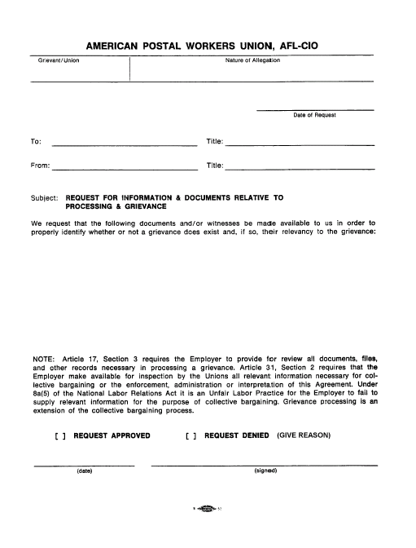
EVIDENCE GATHERED AFTER THE FACT
Request any and all evidence and documents relied upon in issuing the discipline
Management may only rely on information available at the time discipline was issued
Subsequently uncovered information should not be considered
Notes:
You see this quite a bit

Slide 50
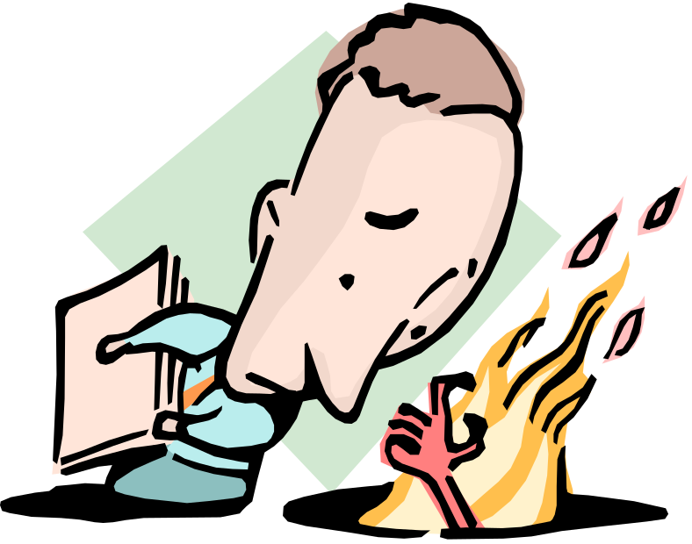
ENTRAPMENT
Employee
  Must not have been predisposed to particular criminal activity, but
  Was induced or “entrapped” into such activity by agent of the employer.
Notes:
Example an informant offers someone sex if they go smoke some weed with them, or buy some from them. Normally that person would not be predisposed but the enticement changed things.

Slide 51
DISCIPLINE REISSUED
Employer may not reissue discipline after it has been resolved through the grievance/arbitration procedure.
Employer may correct procedural errors if it does so before grievance is filed.
Employer may not correct procedural errors raised during the grievance procedure.
Notes:
This is why it is important to point out “mistakes” in the discipline RIGHT AWAY as we have raised the due process or procedural error say at step 1 discussions, they change it, we generally prevail. If they catch the mistake and correct it, we many times do not prevail. This is not a poker game to “hold our cards” we need to reveal it immediately before they can fix it on their own.

Slide 52
DISCIPLINE REISSUED CONT.
DOUBLE JEOPARDY
Stems from criminal law.
Can’t be punished twice for the same misconduct.
RES JUDICATA
Legal principle.
Matter which has been resolved cannot be relitigated.
Notes:
Some arbitrators call it one thing, others the other. Research yours to see which way they call it.

Slide 53
PAPER SUSPENSIONS
The APWU did not sign an agreement for No Time Served Suspensions. When the USPS issues Letters in lieu of a suspension, or unilaterally reduces a removal or suspension to a “paper suspension” it is in violation of Article 16 & Article 5 as well.
If a suspension of 5 days or more is reduced administratively, the reduction should be to a letter of warning rather than a suspension of four days or less, unless such short suspension constitutes an agreed upon settlement of the grievance (JCIM Article 16 page 148).

Slide 54
LAST CHANCE AGREEMENTS (LCA)
Should only be used as a “last resort.”
“Just cause” is generally limited to determination whether the LCA was violated.
Still entitled to basic due process.
Notes:
I will NOT sign a LCA as President Burris told us never to. I agree to a settlement that the grievant has say 45 days to sign the LCA, resign, or the removal stands. Reason is if I sign many arbitrators say the APWU is responsible to explain the LCA. While if only the USPS & the grievant sign the burden is on the USPS. It speaks to the forewarning argument if the person does violate the LCA in some way.

Slide 55
LAST CHANCE AGREEMENTS CONT.
LCA cannot waive employee’s rights under the National Agreement.
  Right to file grievance.
  Numerical attendance standards.
LCA cannot waive employee’s rights under the Law:
  FMLA.
  MSPB.

Slide 56
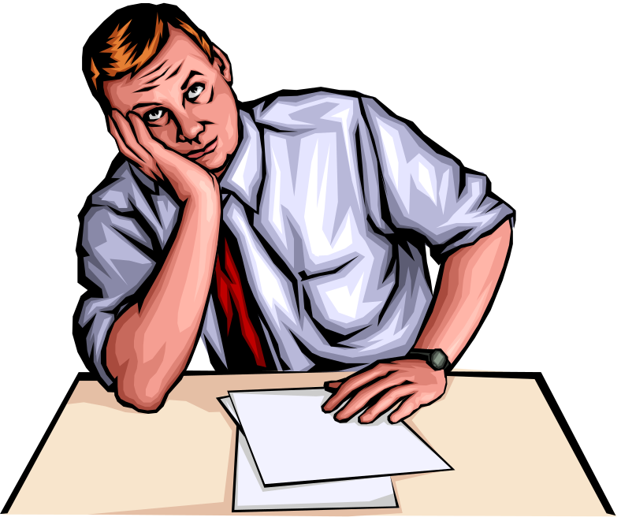
STEP 1
Immediate supervisor’s admission that he/she “doesn’t have the authority”
to resolve a grievance at Step 1 can be fatal to discipline.
You know that I don’t have the authority to do that!

Slide 57
STEP 2
PROCEDURAL ISSUES
Lack of authority to resolve grievance.
  Issuing supervisor.
  Reviewing or concurring official.
Failure to meet at Step 2.
Failure to provide all information relied upon.
Failure to provide a timely Step 2 decision.
Notes:
Also prevail at times when issuing or reviewing supervisor is also step 2 designee. But not with all arbitrators.

Slide 58
DENIED INFORMATION
Union is entitled to all information.
  Relied on by the Employer.
  Requested by the Union for purposes of any affirmative defenses.
Information must be provided in a timely manner.
Notes:
Always put in a RFI for any and all information relied upon in issuing the discipline. If you do not Management can get new evidence into a hearing as rebuttal. If we have proof we requested it, it is blocked and barred from the hearing.

Slide 59

DENIED INTERPRETER
Deaf employees are entitled to reasonable accommodation.
      Certified.
      Other.
Use of interpreters is not limited to handicapped employees.
Notes:
Language as well is needed.

Slide 60

CONCLUSION
REMEMBER:
There is no substitute for a timely investigation.
Interview all witness.
Obtain Statements.
Collect Documents.
Stewards’ Checklist
√ Conduct Interviews
√ Collect Documents
√ Take Notes

Slide 61
QUESTIONS???
ARE THERE
ANY QUESTIONS???

Slide 62

Thanks For Your Attention
and for Your Service
to the Membership!

